Slide 1
IBM University Engagement Project Submission
“Exploring the Power of Agentic AI with IBM Granite and LangFlow”

Slide 2

Project Tile – Fitness Buddy (FitVerse)
Domain of Project – Healthcare
Student Name | Recent Passport Photo | Email ID | Mobile number [WhatsApp]
KEVIN J. TAILOR |  | kevintailor983@gmail.com | +91 8141528111

Slide 3
Problem Statement -Fitness Buddy
The Challenge:-
In today's fast-paced world, maintaining a healthy lifestyle has become increasingly difficult due to busy schedules, lack of personalized guidance, and inconsistent motivation. Many people struggle to follow effective workout routines, make healthy food choices, and build sustainable fitness habits. Traditional fitness solutions often rely on expensive gym memberships, personal trainers, or rigid programs that fail to adapt to individual goals, fitness levels, and daily routines.
As a result, there is a growing need for an intelligent, accessible, and user-friendly virtual fitness assistant that provides personalized guidance anytime and anywhere. Such a solution should offer real-time workout recommendations, nutrition advice, and continuous motivation while adapting to each user's unique needs and preferences.
FitVerse addresses this challenge by providing an AI-powered conversational fitness and wellness coach that can:
Generate personalized home workout plans based on user goals, fitness level, and available time.
Provide daily motivation, fitness tips, and habit-building guidance to encourage long-term consistency.
Recommend simple, nutritious meal ideas and healthy lifestyle suggestions.
Answer fitness-related questions with safe, practical, and easy-to-understand advice.
Promote healthier living through personalized, AI-driven coaching available 24/7.

Slide 4
Proposed Solution: AI-Powered Fitness Agent
The proposed solution is FitVerse, an AI-powered Fitness and Wellness Agent built using IBM watsonx.ai Granite Models, Python Flask, and IBM Cloud Lite Services to provide personalized fitness guidance and healthy lifestyle recommendations. The platform offers an intelligent conversational interface that delivers real-time workout plans, nutrition advice, and wellness support based on user goals and preferences.
The solution consists of four key AI agents:
Workout Planning Agent generates personalized home or gym workout routines based on fitness goals, experience level, available time, and equipment.
Nutrition Guidance Agent recommends balanced meal plans, calorie intake, hydration goals, and healthy food suggestions tailored to user preferences.
Motivation & Habit Agent provides daily motivation, fitness challenges, and habit-building tips to encourage long-term consistency.
Health Advisory Agent offers safe exercise guidance, recovery tips, stretching routines, and general wellness recommendations with appropriate medical disclaimers.
The platform also includes interactive tools such as BMI Calculator, BMR Calculator, Calorie Calculator, and Water Intake Calculator, along with a responsive dashboard that displays AI-generated workout plans, nutrition insights, health metrics, and daily fitness recommendations.
Powered by IBM watsonx.ai Granite Models, FitVerse delivers an intelligent, personalized, and accessible fitness coaching experience, helping users build healthier habits and achieve their long-term wellness goals.

Slide 5
Technology Used
IBM watsonx.ai Granite Model – Powers conversational AI, personalized workout generation, nutrition guidance, and fitness recommendations.
IBM Cloud Lite Services – Provides a secure, reliable, and scalable cloud platform for deploying the application.
Python Flask – Backend framework for application logic, AI integration, and API management.
Bootstrap 5 – Builds a modern, responsive, and user-friendly interface.
HTML, CSS & JavaScript – Create an interactive and dynamic frontend experience.
Chart.js – Visualizes BMI, calorie estimates, hydration goals, and fitness insights using interactive charts.
Python Dotenv (.env) – Securely manages IBM Cloud API keys and environment variables.

Slide 6
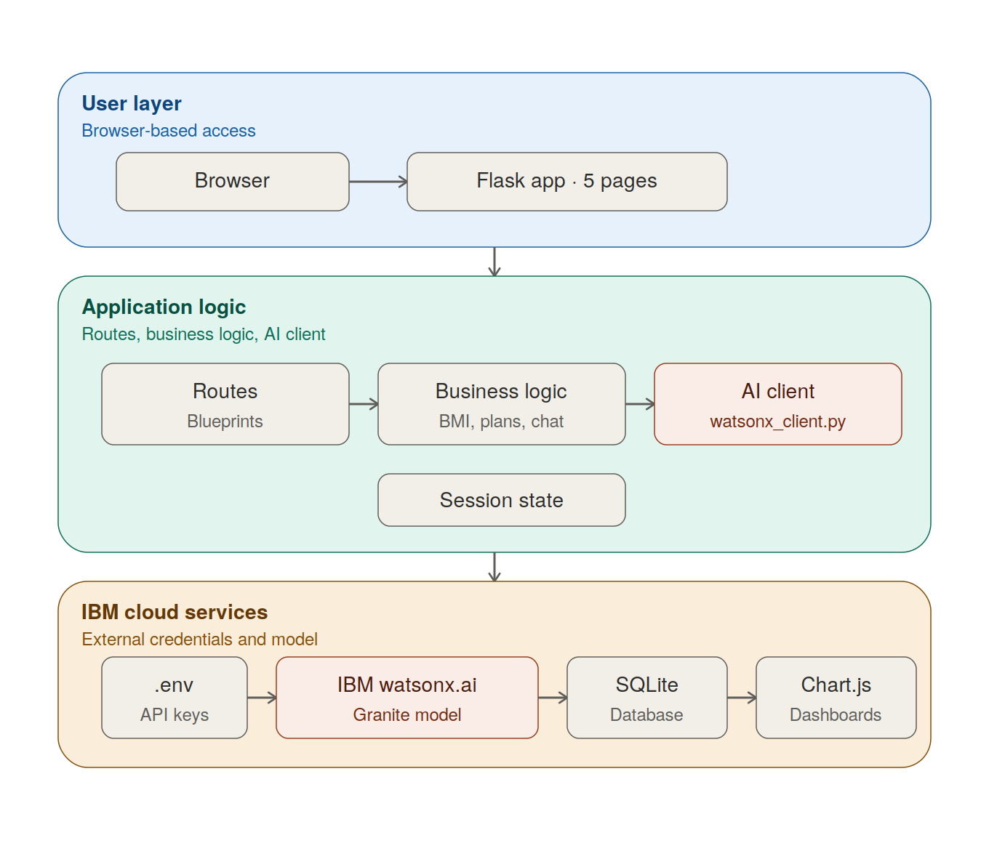
Architecture -

Slide 7
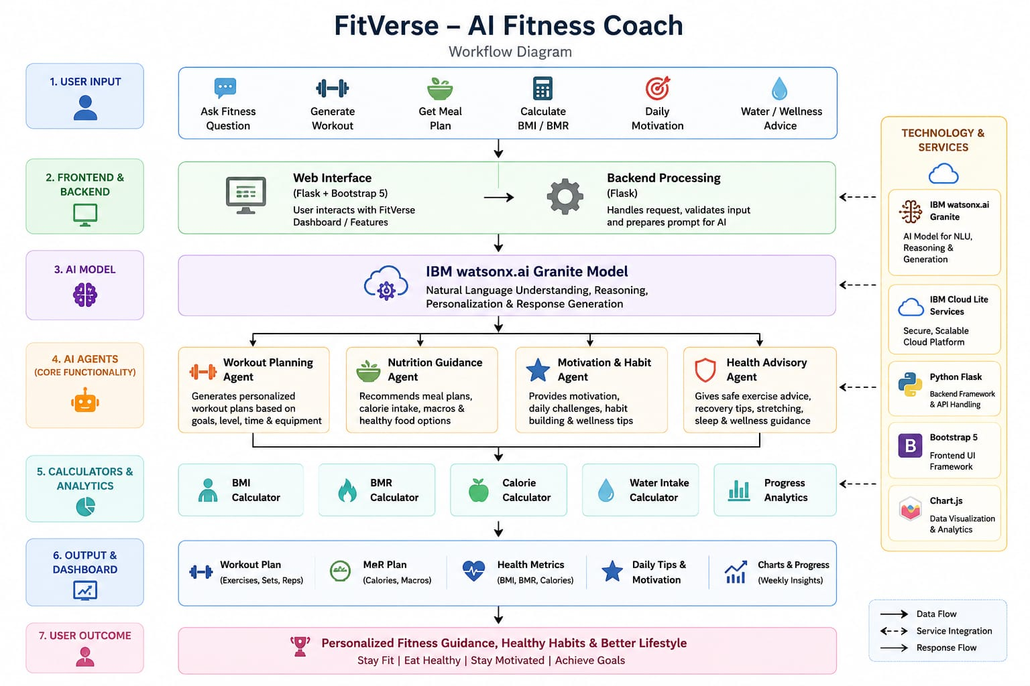
Architecture/Workflow Blueprint

Slide 8

Role of Agentic AI in the solution
Role of Agentic AI in Fitness Agent:-
FitVerse leverages Agentic AI to function as an intelligent virtual fitness coach that understands user goals, reasons about their requirements, and delivers personalized recommendations. Instead of providing static responses, the AI analyzes user inputs such as fitness goals, workout preferences, dietary choices, and available time to generate customized workout plans, nutrition guidance, and motivational support.
The Agentic AI autonomously performs specialized tasks through multiple AI agents, including:
Workout Planning Agent – Creates personalized exercise routines.
Nutrition Guidance Agent – Recommends healthy meals and calorie intake.
Motivation & Habit Agent – Encourages consistency through daily tips and fitness challenges.
Health Advisory Agent – Provides safe workout practices and general wellness recommendations.
By combining natural language understanding with intelligent reasoning using IBM watsonx.ai Granite Models, Agentic AI enables FitVerse to deliver real-time, context-aware, and personalized fitness coaching, making healthy living more accessible, interactive, and engaging.

Slide 9
Novelty and Uniqueness
The proposed FitVerse stands out by combining Agentic AI, IBM watsonx.ai Granite Models, and personalized fitness coaching into a single intelligent wellness platform.
Multi-Agent Intelligence – Specialized AI agents collaborate to provide personalized workout plans, nutrition guidance, motivation, and wellness recommendations.
Personalized Fitness Coaching – Generates customized workouts and meal suggestions based on user goals, fitness level, available time, and dietary preferences.
Conversational AI Experience – Enables users to interact naturally with an AI fitness coach for instant guidance and real-time recommendations.
Integrated Health Tools – Combines BMI, BMR, calorie, and hydration calculators with AI-powered insights in one platform.
Motivation & Habit Building – Encourages long-term consistency through daily fitness tips, wellness challenges, and healthy habit recommendations.
Accessible & User-Friendly – No login or subscription required, allowing users to access AI-powered fitness guidance instantly from any device.
Scalable & AI-Powered – Built on IBM watsonx.ai Granite Models and IBM Cloud Lite Services, ensuring intelligent, reliable, and scalable performance.

Slide 10
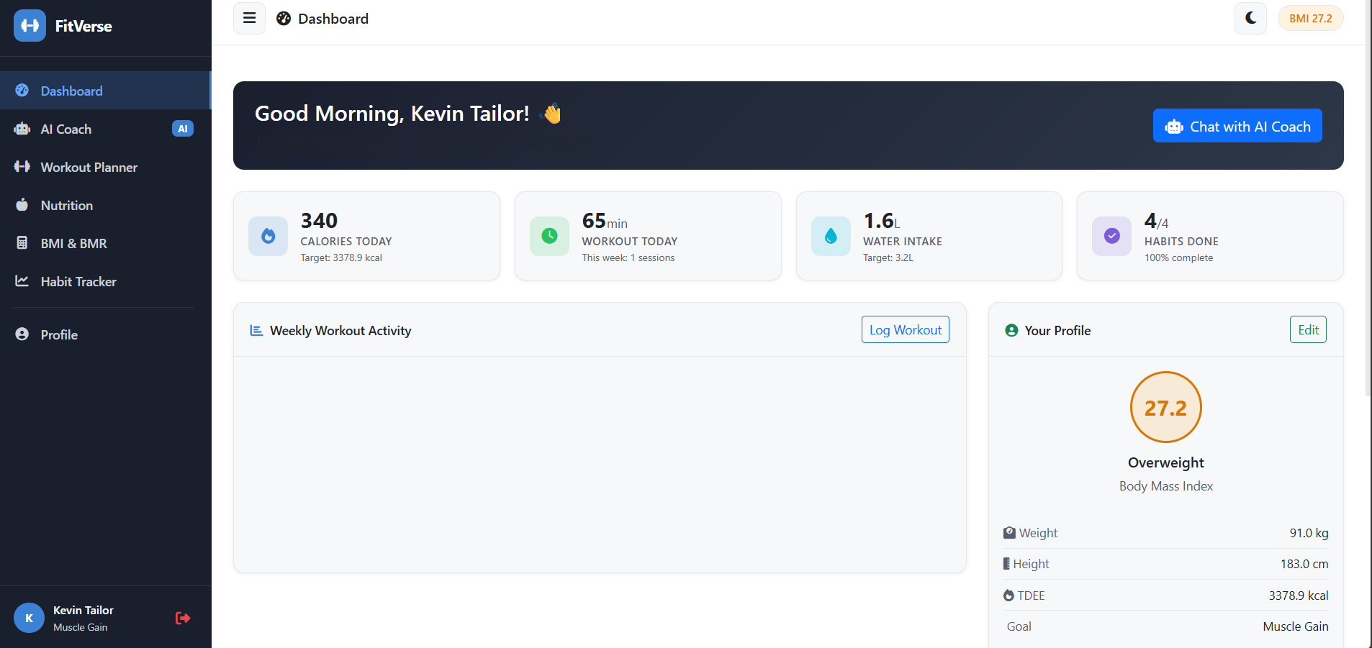

Slide 11
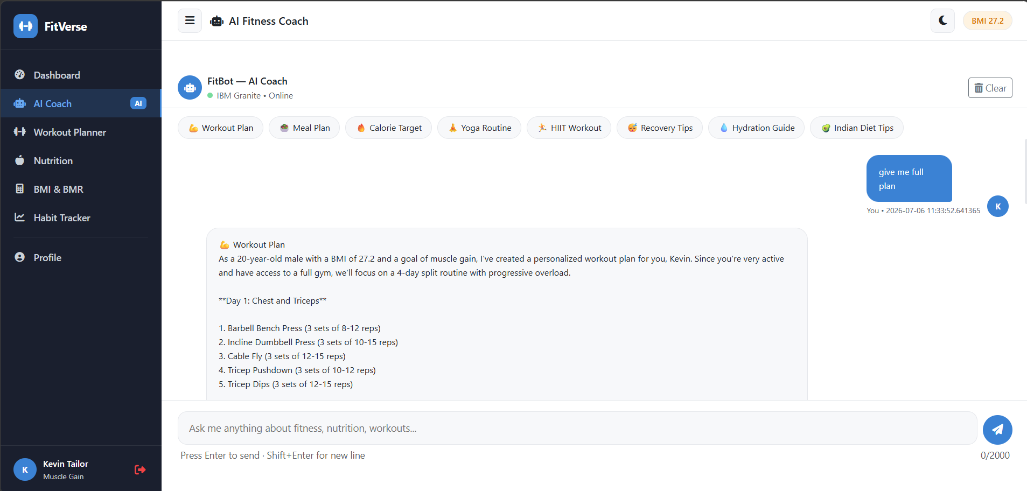

Slide 12
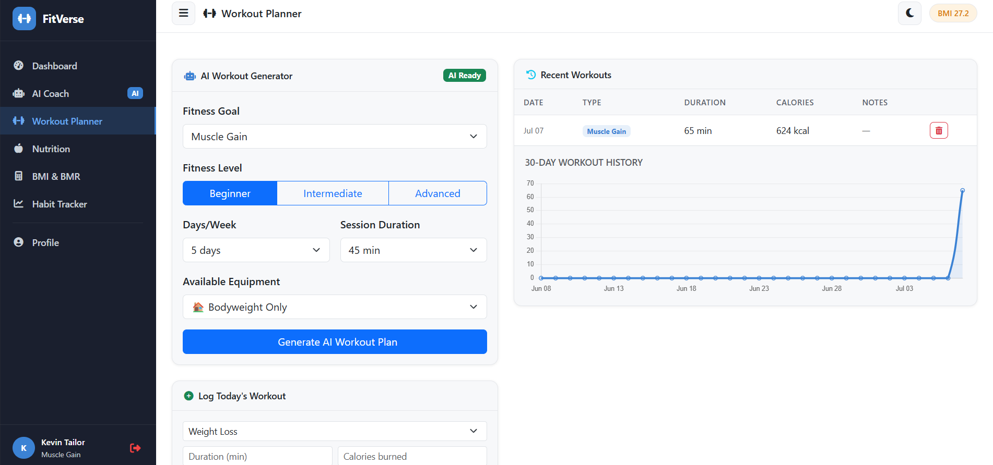

Slide 13
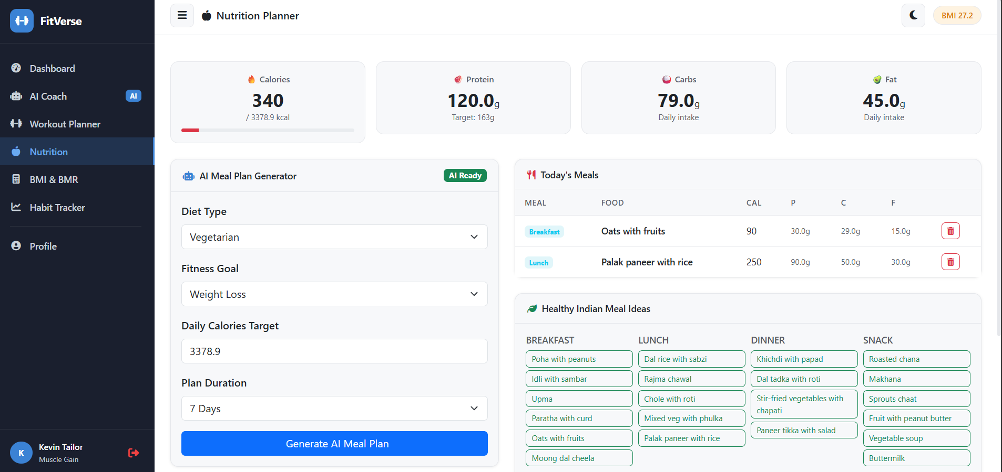

Slide 14
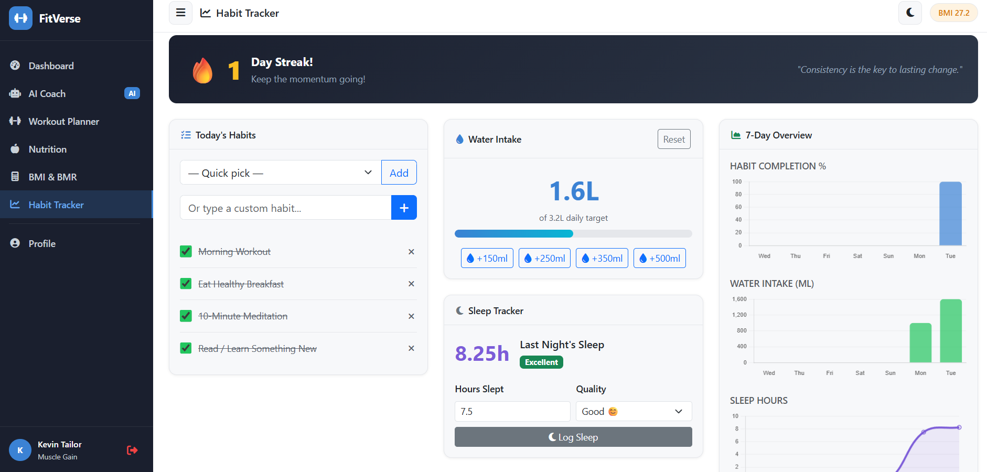

Slide 15
GitHub Link + Live Demo:-
GitHub Link
https://github.com/KevinTailor102/Fit-Verse.git
Live Server
https://fit-verse.onrender.com

Slide 16
Future Scope
Integration with Wearables & Smart Health Devices
FitVerse can be integrated with smartwatches and fitness trackers (such as Fitbit, Apple Watch, or Google Fit) to collect real-time data including heart rate, step count, calories burned, sleep patterns, and physical activity. This will enable the AI to generate more accurate workout plans, nutrition recommendations, and wellness insights based on live health data.
2. AI Voice Coach & Multilingual Support
Future versions can include a voice-enabled AI fitness coach with multilingual support, allowing users to interact naturally through voice commands in their preferred language. This will improve accessibility, enhance user engagement, and make FitVerse more inclusive for users from diverse linguistic and cultural backgrounds.
.
·
·
·

Slide 17
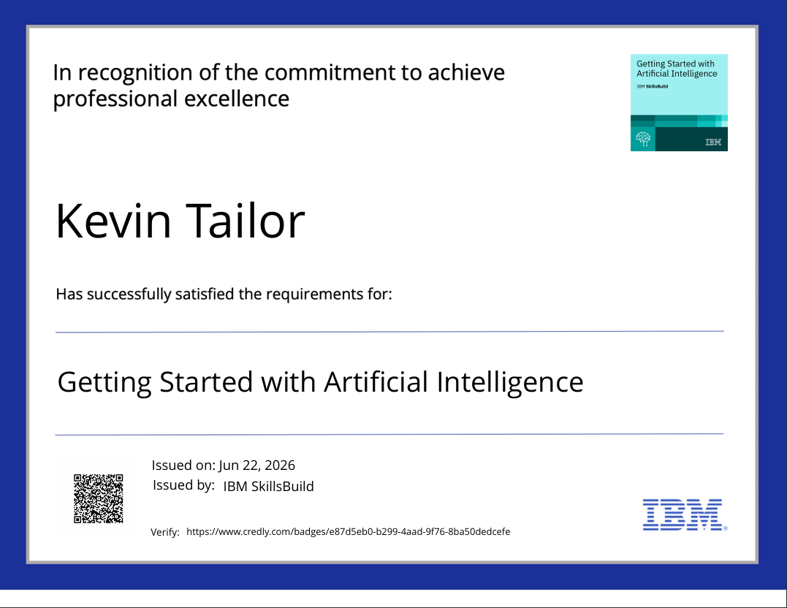
Certificates Earned:
Credly certificate:-

Slide 18
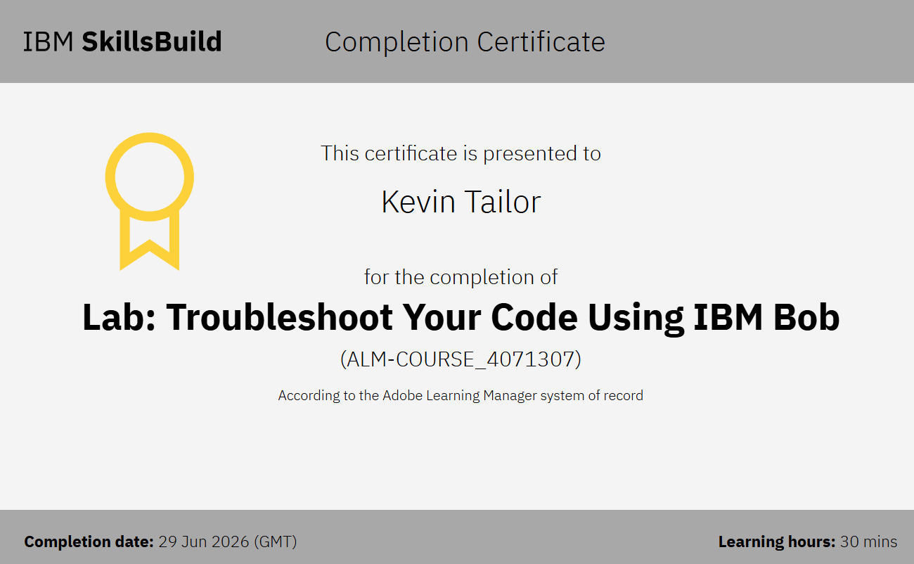
Certificates Earned:​
IBM BOB Certificate:-

Slide 19


